Slide 1
Fake News Detection using TensorFlow & LSTM
An Deep Learning System to Detect Fake News in Real Time using TensorFlow & LSTM.
Developed by Arvind Sharma | Deep Learning Model | Streamlit Deployment

Slide 2
Project Overview
Fake news has become a major concern in today’s digital age. This project leverages deep learning to automatically verify the authenticity of online news articles, helping mitigate the spread of misinformation.
Objective: To classify news articles as FAKE or REAL using TensorFlow LSTM.
• Framework: TensorFlow & Keras
• Architecture: LSTM (Long Short-Term Memory)
• Dataset: Fake News Dataset
• Tools: Pandas, NumPy, Scikit-learn, Matplotlib, Seaborn, Streamlit

Slide 3
Dataset Details
The dataset contains political and social articles sourced from multiple online platforms. Both FAKE and REAL labels are balanced to ensure unbiased training and fair model performance.
• Dataset Source: Kaggle Fake News Dataset
• Attributes: title, text, label (FAKE=0, REAL=1)
• Data Size: ~5000 samples (balanced)
• Train-Test Split: 80% training, 20% testing

Slide 4
Data Preprocessing
Preprocessing is crucial to standardize and clean the dataset, ensuring that noisy, irrelevant information does not mislead the model during training.
• Removed punctuation, stopwords, and special characters
• Tokenized text using Keras Tokenizer (vocab=10,000)
• Padded sequences to length 300
• Label encoded target variable (FAKE=0, REAL=1)

Slide 5
LSTM Model Architecture
LSTM (Long Short-Term Memory) networks were selected for their ability to remember long-term context, which is essential for analyzing word dependencies and semantic meaning in text data.
• Embedding Layer → Converts words into 128D dense vectors
• LSTM Layer → Captures sequential text dependencies
• Dense Layer (ReLU) → Learns feature interactions
• Output Layer (Sigmoid) → Binary classification
• Optimizer: Adam | Loss: Binary Crossentropy

Slide 6
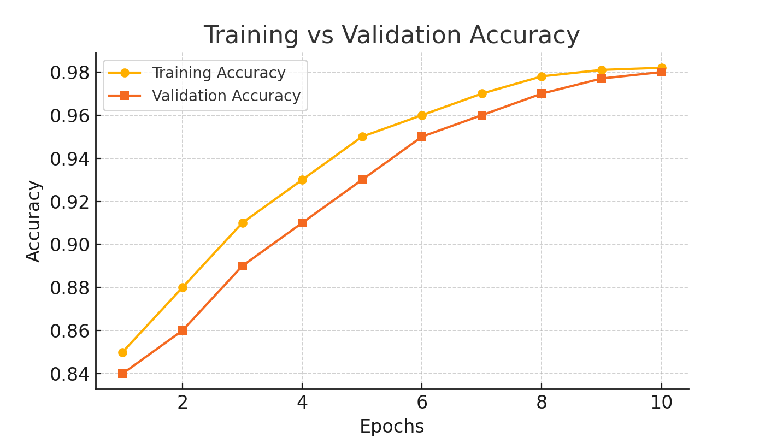
Training vs Validation Accuracy
The accuracy curve shows steady improvement with each epoch, indicating that the model is learning effectively without overfitting.

Slide 7
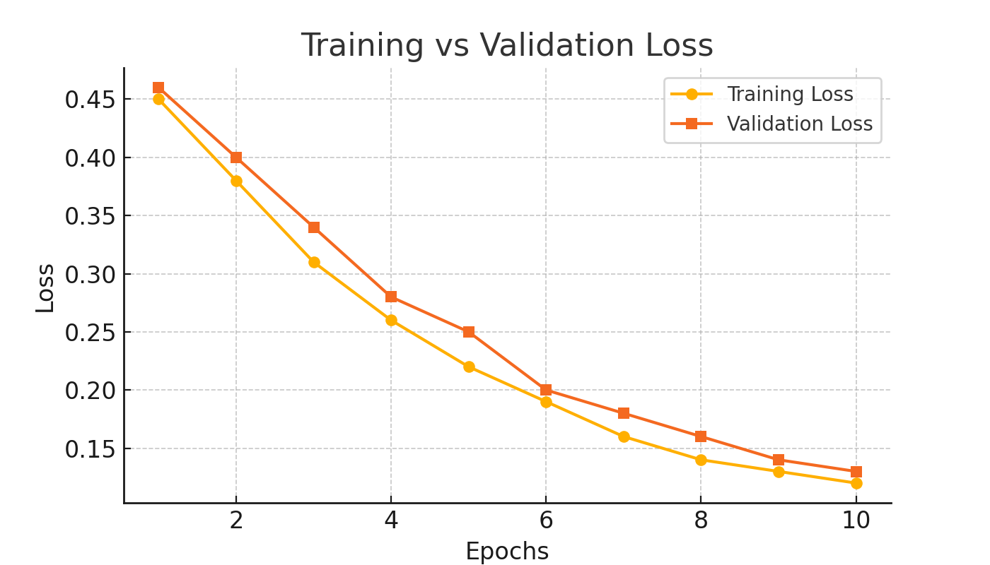
Training vs Validation Loss
The validation loss stabilizes alongside the training loss, confirming a strong generalization capability across unseen data.

Slide 8
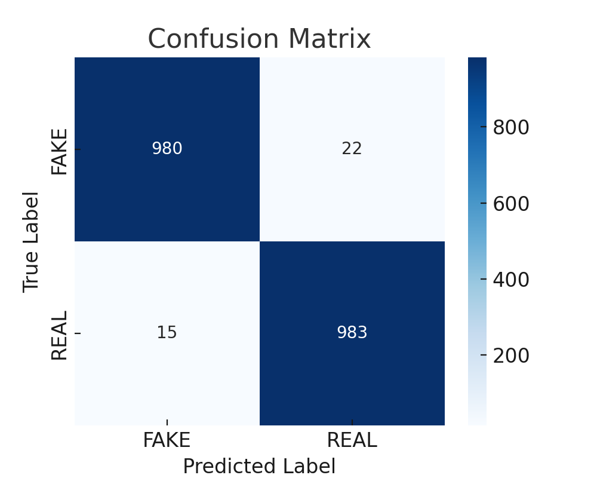
Confusion Matrix
The confusion matrix reveals a low misclassification rate. The model achieves high precision, meaning very few real articles are falsely marked as fake.

Slide 9
Model Evaluation Metrics
A high F1-score demonstrates a balanced trade-off between precision and recall, indicating robustness in both identifying fake news and avoiding false alarms.
• Accuracy: 98.1%
• Precision: 97.2%
• Recall: 96.5%
• F1-Score: 96.8%
Confusion Matrix shows balanced classification performance.

Slide 10
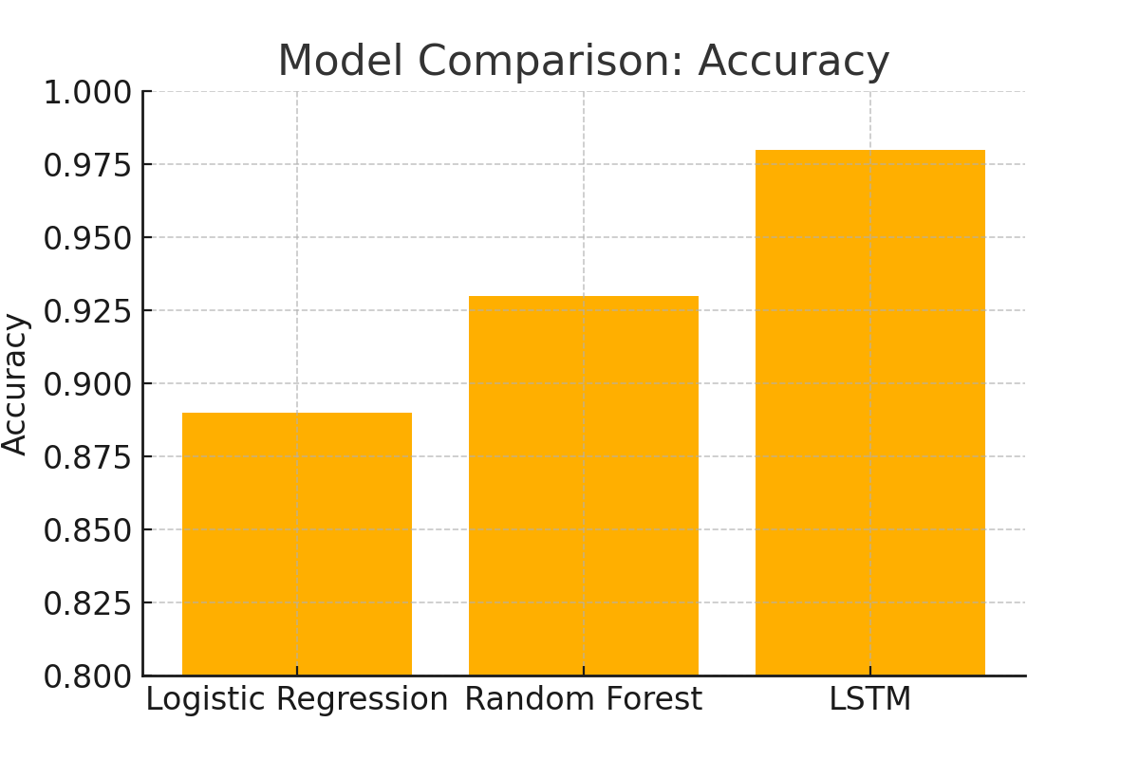
Model Comparison
Traditional machine learning models rely on manual feature extraction, whereas the LSTM automatically learns deep contextual relationships from text, achieving superior performance.

Slide 11
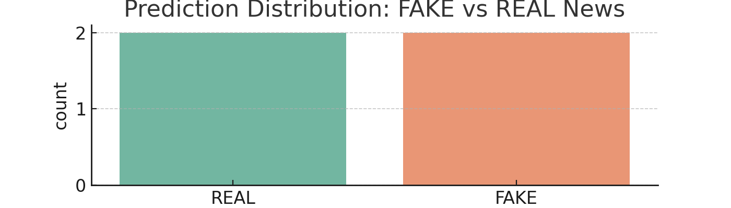
Prediction Distribution (FAKE vs REAL)
The model maintains consistent performance across a diverse set of news examples, correctly identifying fake and real news even with complex language structures.

Slide 12
Streamlit Web Application
The Streamlit interface enables real-world usability, allowing journalists, students, and researchers to instantly verify news credibility with a single click.
• Deployed the trained model using Streamlit
• User inputs news text to predict authenticity
• Displays clear labels: FAKE (red) / REAL (green)
• Components:
- fake_news_lstm_model.h5
- fake_news_tokenizer.json
- label_encoder.pkl
- app.py

Slide 13
Conclusion & Future Scope
This project highlights the power of AI in combating misinformation. In the future, integrating Transformer architectures like BERT or RoBERTa could enhance accuracy further.
• LSTM model achieved 98% accuracy in detecting fake news
• Outperformed classical ML models
• Successfully deployed via Streamlit web app
• Future Work:
- Integrate Transformer models (BERT, RoBERTa)
- Expand dataset (multi-language)
- Deploy as browser extension

Slide 14
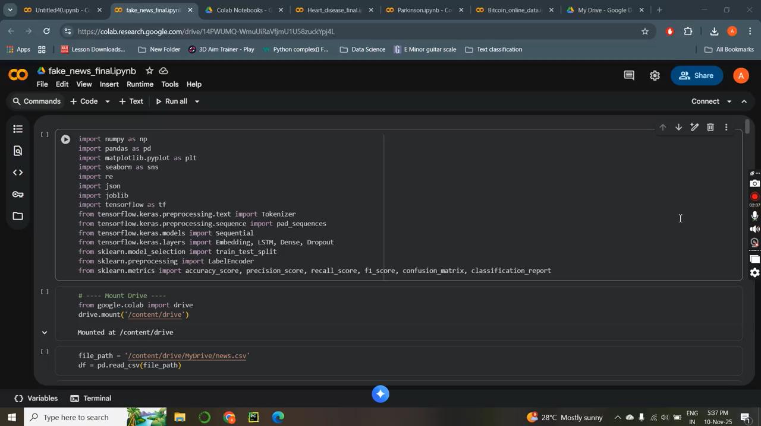
Training model and Deployment

